Slide 1
Overview of Scrum

Slide 2
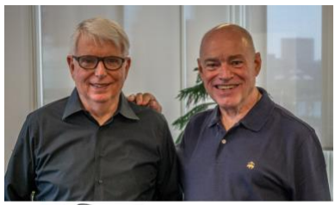
Definition of Scrum
Scrum : A framework within which people can address complex adaptive problems, while productively and creatively delivering products of the highest possible value.
Scrum is:
• Lightweight
• Simple to understand
• Difficult to master

Slide 3
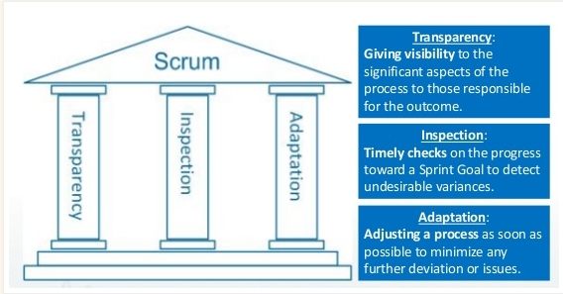
Scrum Theory

Slide 4
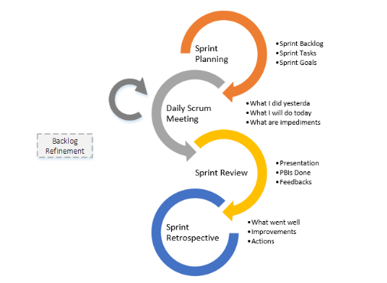

Slide 5
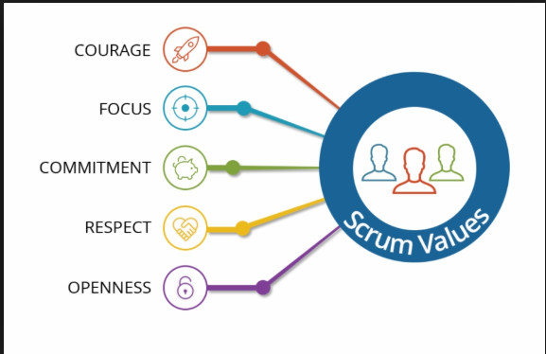
Scrum values

Slide 6
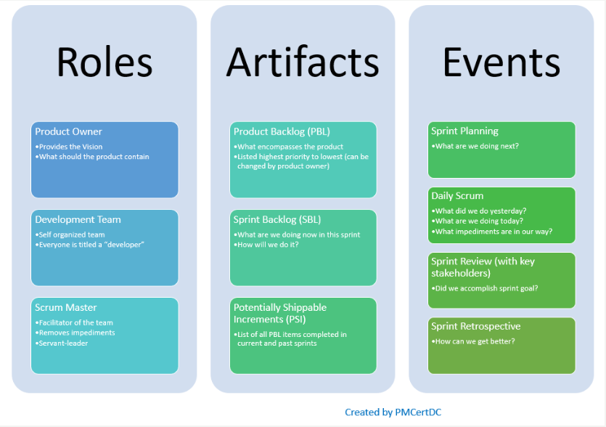

Slide 7
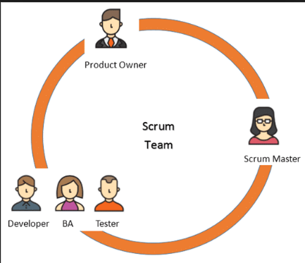
The Scrum Team

